Slide 1
Welcome!
As you get settled, please complete the final setup:
Go to https://github.com/mauro3/CORDS and download (or clone or pull) the repository.
Navigate to the directory Workshop-Geodata-Processing and create a directory called ‘data’.
Start your conda environment (conda activate cords-geoprocessing)
Start jupyter notebook
Open Download-data.ipynb and run the first three cells to download the vector datasets. Let us know if you run into issues!

Slide 2
Program
About me / participant introductions
Workshop goals
Overview over some useful packages
Working with vector data
Working with raster data
Working with multispectral data (if time permits)
Small project work (if time permits)

Slide 3
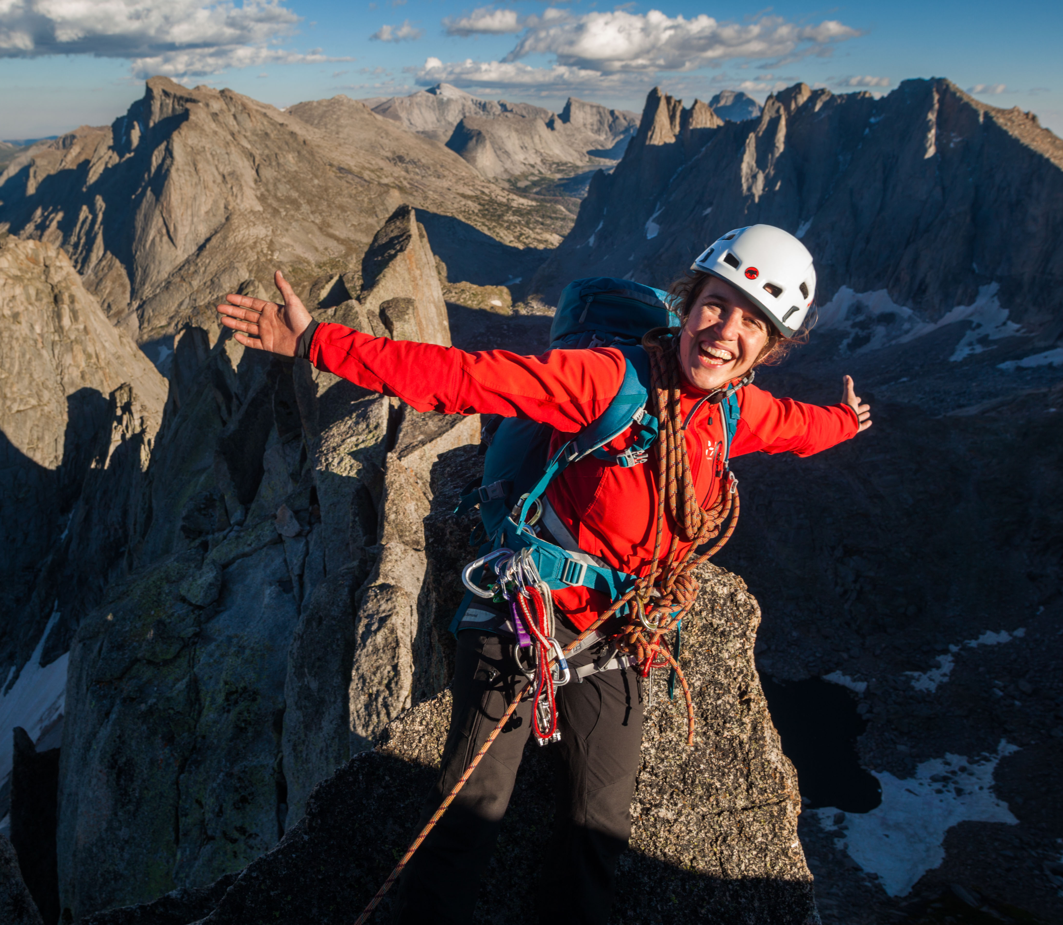
About me
BSc / Msc in Geography at UZH and master’s thesis at WSL
PhD at University of Colorado at Boulder
Postdoc in glaciology at VAW / WSL
Work on glacier and mountain hazards in a changing climate
No formal background in programming
Mostly learning by doing

Slide 4

And what about you?
What is your name (share pronouns if you feel like)?
Where do you work and what do you work on?
What is your favorite (or least favorite ;-) ) spatial dataset that you work on, have worked with, or will use in the future?

Slide 5
Why write code rather than use a GIS?
You can run the same operation many times over. (Especially useful when you realize that you made a mistake somewhere along the way).
Your future self will be able to benefit from the work you do now by re-using your code.
You can easily regenerate the same figures / maps and make those changes the the reviewers asked for.
Others can use your code and reproduce your research.

Slide 6
Goals of the course
Familiarize yourself with some common packages that can be used to work with geospatial data in python.
Get familiar with how spatial data is stored in python.
Gain experience reading and writing spatial data, including open-source vector file formats.
Practice manipulating vector and raster data: query metadata, spatial operations, reprojections etc.
Gain experience creating maps in python.

Slide 7
Common geospatial packages
Vector data
Raster data
geopandas
xdem
rioxarray
fiona
shapely
rasterio
pandas
gdal
matplotlib
geos (C++)

Slide 8
Common geospatial packages
Vector data
Raster data
geopandas
xdem
rioxarray
fiona
shapely
rasterio
pandas
gdal
matplotlib
geos (C++)

Slide 9
Working with vector data
Loading and investigating a vector dataset with geopandas
Investigating the geometry part
Plotting
Spatial filtering
Typical geometric operations
Writing spatial data with geopandas
Adding spatial data from tabular resources
Spatial operations with point data

Slide 11
Shapely geometry
Pandas DataFrame

Slide 12
shapely

Slide 13
EPSG codes

Slide 14
Working with raster data
Loading and inspecting raster data with rasterio
Loading, reprojecting, and manipulating raster data with xdem
Extracting data from rasters: points, polygons, multipolygons
Writing raster data with python

Slide 15
rasterio
Python library for reading and writing geospatial raster data, built on top of GDAL (Geospatial Data Abstraction Library

Slide 19
A note on indexing
0,0
0,0
Typical cartesian: x, y
Typical python: row, column

Slide 20
Project work
Datasets:
Swiss Glacier Inventory (outlines and more)
Digital elevation models: 2014 and 2020
Glathida ice thickness measurements
Modelled ich thicknesses: global and for swiss glaciers
…
Goal:
Analysis of your choice and two-panel figure

